Slide 2
Entry Points into a Program
We all know that we need to find a switch, click "Start", or perform a similar action to get the washing machine running, to get the TV on, etc. If it is a robot, there is surely a switch. With programs, we often think of the "RUN" command, or the Green Flag in Scratch. And that seems the only moment to enter the program, like opening up the Calculator software from the Program list. Once opened, it is running, in the continuous sense.
This is of course very true. But it doesn't seem very useful, as there is only one entry point to consider. Yet, if we think of a bigger program that contains several smaller subprograms, then we can talk about the entry points into the smaller programs. A "program" is just a collection of instructions. At any time, we can consider, how you get to enter this part of your program, in what setting, with what prerequisites, the program enters into a special part of code.
In the previously week, you have tried the when-backdrop-switches-to-x instruction block. It was the entry point of scene 2 of the story, to start the blocks below it when the condition is right.

Slide 3
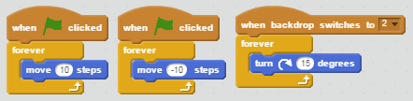
Conflicts of Actions
There is a reason why we suggest you to think of the when-backdrop-switches-to-x instruction block as an entrance to a different subprogram. The alternative, usual way of thinking is to trace the sequence of instructions, line by line. When you think of a sequence, you will assume that the previous one finishes before the next one starts. When we "enter" a new subprogram, the other programs needs not be finished. This is more the case here.
Look at the below picture.
You should have learned from the Homework last week that the two when-green-flag-clicked instructions will both run. In this case, the Sprite will not move because the two actions cancel each other. And then, when we switch the backdrop to "2", the when-backdrop-switches-to-2 instruction will not hesitate to join in. The two when-green-flag-clicked blocks will not cease running because of a new fellow joining. All three blocks run together.
This is not very desirable. First, it's difficult to see whether your logic goes wrong or not when the actions cancel each other and hide under each other. Second, it's wasting computer resources!

Slide 4
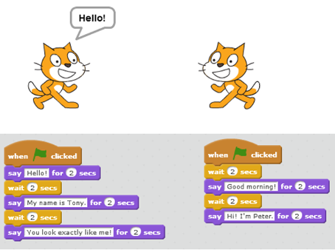
The "UNTIL" Entry Point
Except when the program is ill designed to invoke conflicts of actions, it is good to have parallel when-green-flag-clicked instructions, to handle different actions. Such needs arise here and then, for example, having the Sprite change costumes, while it runs around for different business on stage. It is possible to manually intertwine the actions into one when-green-flag-clicked group, but why trouble ourselves when we could have a clean design with parallel blocks?

Slide 5
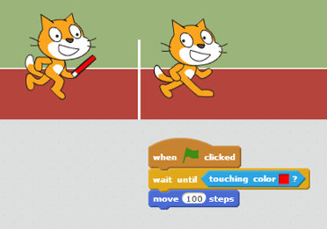
The "UNTIL" Entry Point
Then, it often comes about that a parallel block does not need to come in immediately after the Green Flag is clicked. We've learned to use the wait-x-secs instruction to delay its entry. However, such timing was manually calculated. It could be inaccurate, and above all, troublesome. In this module, we will learn to use the wait-until instruction block to delay an entry point till the situation is favourable.
Last but not least, you should also take note of the repeat-until instruction. It also signifies some kind of indefinite longing, except that the Sprite will repeat some action before the situation is favourable. Recall the impatient frog jumping up and down, waiting for the princess.

Slide 6
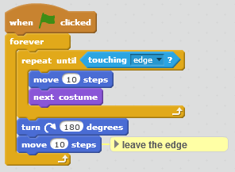
Steps of the example
We start with a blank project. Below are all the blocks used to complete this example. You should put all code blocks in Sprite1. There are no other Sprites used.
Try to remove the last move-10-steps instruction block and run again to see what will happen.

